Slide 1

EXCEPTION HANDLING

Slide 2
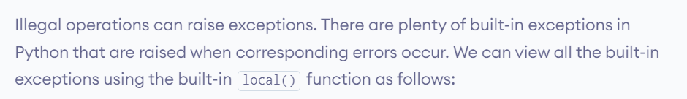
Default Exception and Errors
print(dir(locals()['__builtins__']))

Slide 3
exception BaseException
This is the base class for all built-in exceptions. It is not meant to be directly inherited by user-defined classes. For, user-defined classes, Exception is used. This class is responsible for creating a string representation of the exception using str() using the arguments passed. An empty string is returned if there are no arguments.

Slide 4
exception ArithmeticError
This class is the base class for those built-in exceptions that are raised for various arithmetic errors such as :OverflowError
ZeroDivisionError
FloatingPointError

Slide 5
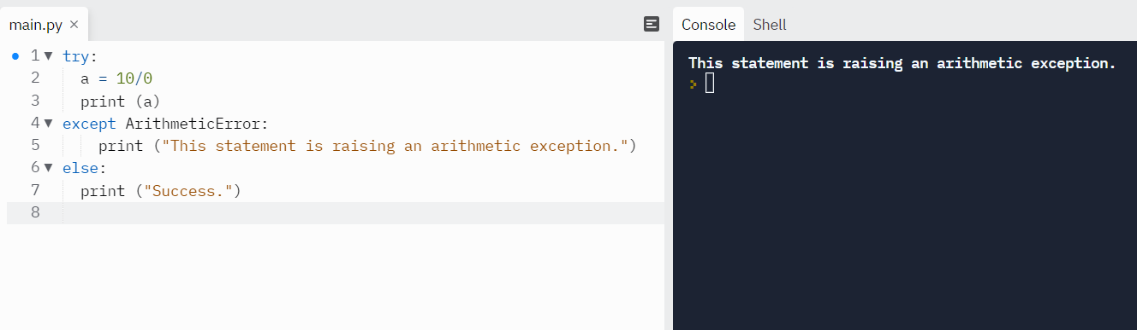

Slide 6
exception BufferError
This exception is raised when buffer related operations cannot be performed.
exception LookupError
This is the base class for those exceptions that are raised when a key or index used on a mapping or sequence is invalid or not found. The exceptions raised are :
  KeyError
  IndexError

Slide 7
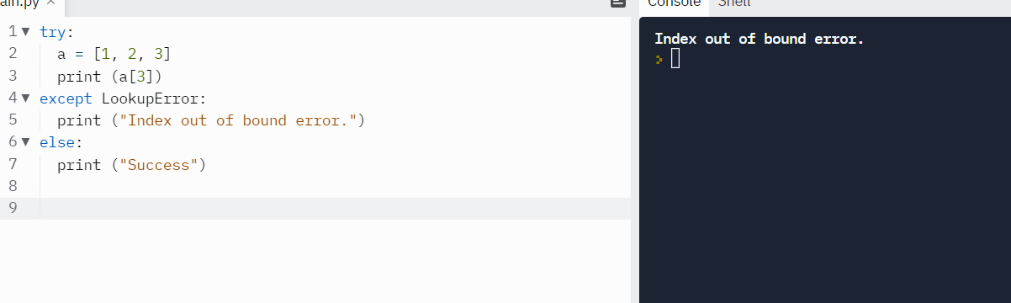

Slide 8
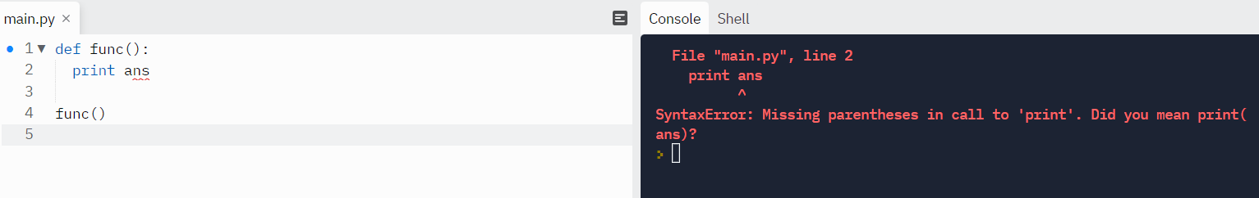
exception NameError
This error is raised when a local or global name is not found. For example, an unqualified variable name.

Slide 9
Finally Keyword in Python
Python provides a keyword finally, which is always executed after the try and except blocks. The finally block always executes after normal termination of try block or after try block terminates due to some exception.
Syntax:
try:
# Some Code....
except:
# optional block
# Handling of exception (if required)
else:
# execute if no exception
finally:
# Some code .....(always executed)

Slide 10
Some of the common built-in exceptions are other than above mention exceptions are:
Exception Description
IndexError When the wrong index of a list is retrieved.
AssertionError It occurs when assert statement fails
AttributeError It occurs when an attribute assignment is failed.
ImportError It occurs when an imported module is not found.
KeyError It occurs when the key of the dictionary is not found.
NameError It occurs when the variable is not defined.
MemoryError It occurs when a program run out of memory.
TypeError It occurs when a function and operation is applied in an incorrect type.

Slide 11
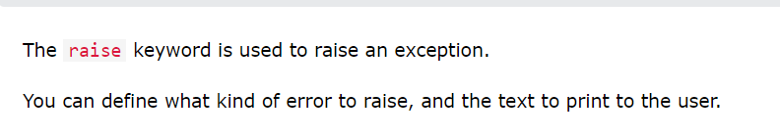
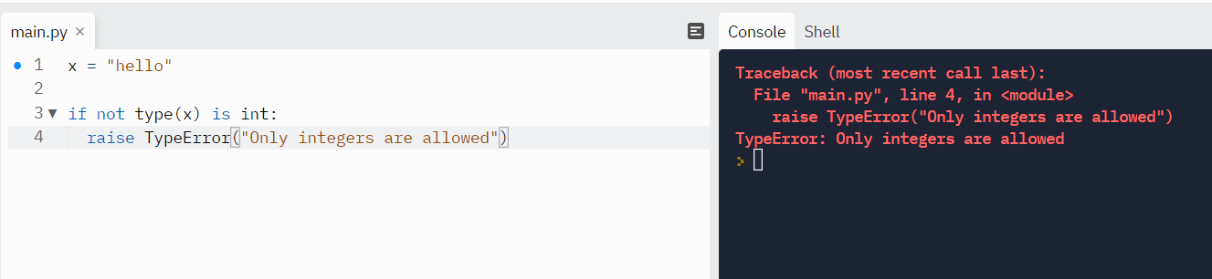
Raise an exception

Slide 12
Try, Except, else and Finally in Python
An Exception is an Event, which occurs during the execution of the program. It is also known as a run time error. When that error occurs, Python generates an exception during the execution and that can be handled, which avoids your program to interrupt.

Slide 13
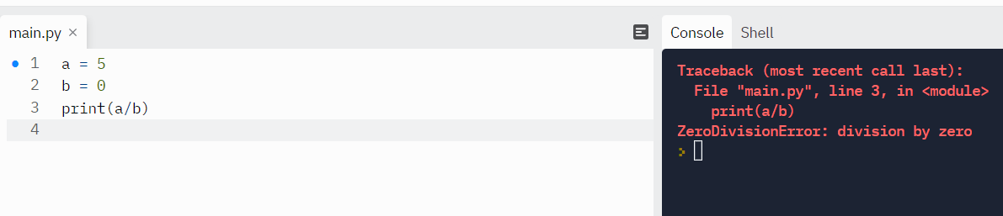

Slide 14
continue
Try: This block will test the excepted error to occur
Except: Here you can handle the error
Else: If there is no exception then this block will be executed
Finally: Finally block always gets executed either exception is generated or not

Slide 15
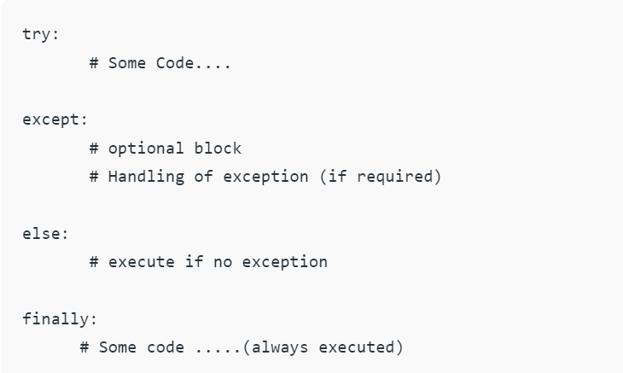

Slide 16
First try clause is executed i.e. the code between try and except clause.
If there is no exception, then only try clause will run, except clause will not get executed.
If any exception occurs, the try clause will be skipped and except clause will run.
If any exception occurs, but the except clause within the code doesn’t handle it, it is passed on to the outer try statements. If the exception is left unhandled, then the execution stops.
A try statement can have more than one except clause.

Slide 17
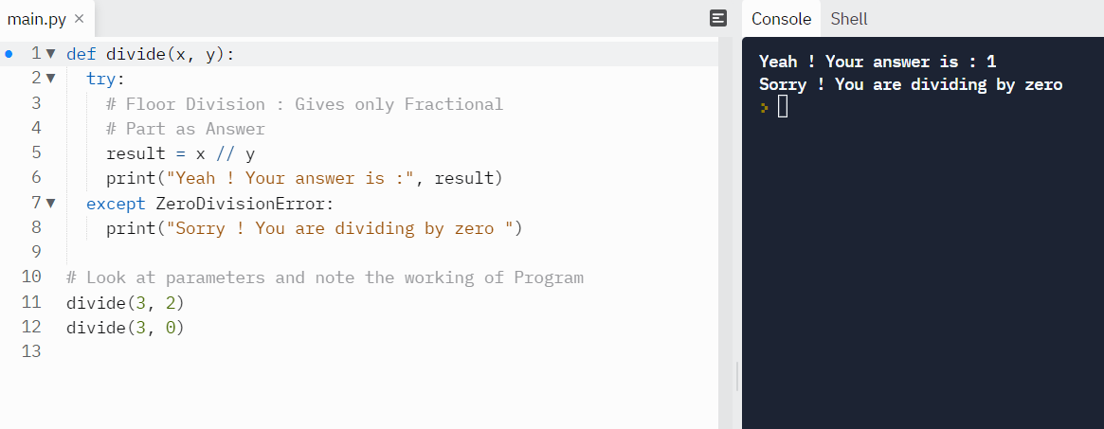

Slide 18
Else Clause
The code enters the else block only if the try clause does not raise an exception.
Example: Else block will execute only when no exception occurs.

Slide 19
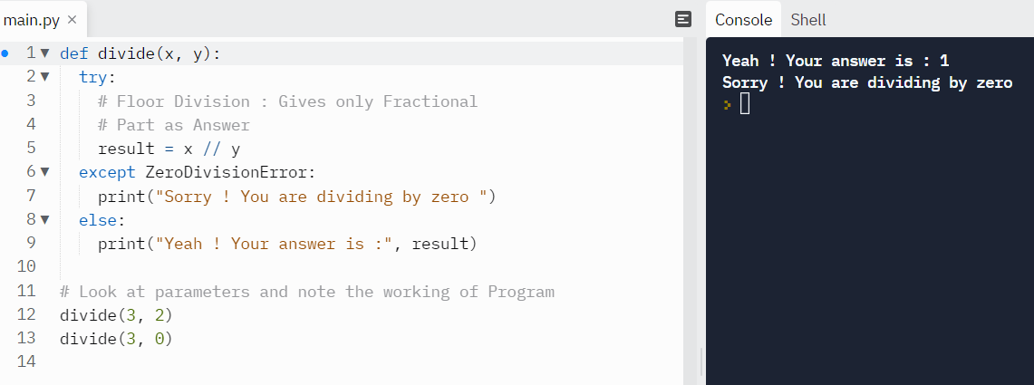

Slide 20
Finally Keyword
Python provides a keyword finally, which is always executed after try and except blocks. The finally block always executes after normal termination of try block or after try block terminates due to some exception.
Example: Let’s try to throw the exception in except block and Finally will execute either exception will generate or not

Slide 21
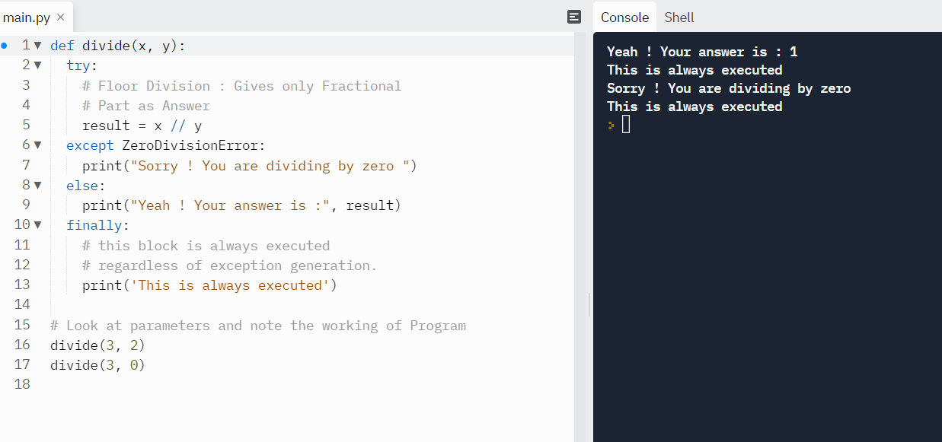

Slide 22
User-defined Exceptions in Python
Python throws errors and exceptions when there is a code gone wrong, which may
cause the program to stop abruptly. Python also provides an exception handling
method with the help of try-except. Some of the standard exceptions which are
most frequent include IndexError, ImportError, IOError, ZeroDivisionError, TypeError,
and FileNotFoundError. A user can create his own error using the exception class.
Creating User-defined Exception
Programmers may name their own exceptions by creating a new exception class.
Exceptions need to be derived from the Exception class, either directly or indirectly.
Although not mandatory, most of the exceptions are named as names that end in
“Error” similar to the naming of the standard exceptions in python.

Slide 23
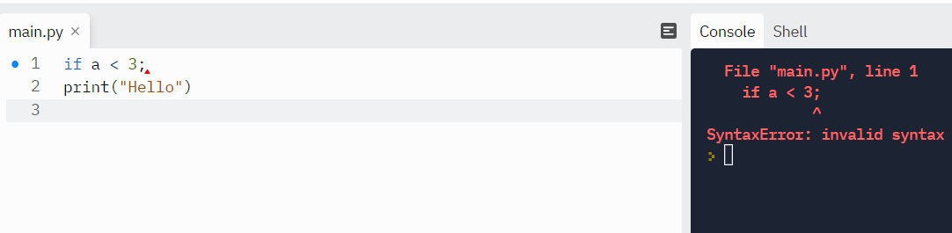
Python Syntax Errors
Error caused by not following the proper structure (syntax) of the language is called syntax error or parsing error.

Slide 24
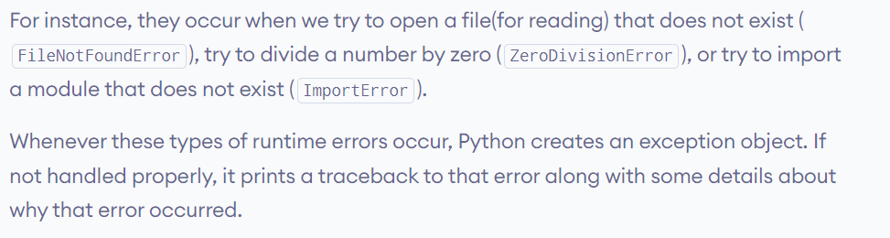
Python Logical Errors (Exceptions)
Errors that occur at runtime (after passing the syntax test) are called exceptions or logical errors.

